Slide 1
Chapter 5: Advanced SQL

Slide 2
Chapter 5: Advanced SQL
Accessing SQL From a Programming Language
Dynamic SQL
JDBC and ODBC
Embedded SQL
SQL Data Types and Schemas
Functions and Procedural Constructs
Triggers
Advanced Aggregation Features
OLAP

Slide 3
ODBC(Open DataBase Connectivty：开放数据库互连)
ODBC是Microsoft Windows Open Standards Architecture (WOSA,Windows开放服务体系)的重要组成部分,由Microsoft公司于1991年底发布,短短几年已成为事实上的工业标准.它建立了一组规范,提供了一套分层(随着层的扩展,数据服务能力不断的增强)的标准API(支持SQL),它解决了嵌入式SQL接口的非规范核心,数据应用系统用它来访问任何提供了ODBC驱动程序(一组DLL)的数据库,结束了过去针对不同的数据库系统开发须掌握相应数据访问API的时代.事实上,可将ODBC体系看作统一的数据访问界面,而使这种统一的数据访问成为可能的就是各数据库产品厂商提供的相应的ODBC Provider(ODBC提供者即ODBC 驱动)。

Slide 4
ODBC应用的结构
应用程序
应用程序
应用程序
Odbc API
ODBC DRIVER MANAGER
Odbc API
ORACLE DRIVER
DB2 DRIVER
SYBASE DRIVER
SQL SERVER DRIVER
ORACL DBMS
DB2 DBMS
SYBASE DBMS
SQL SERVERDBMS

Slide 5
ODBC的体系结构（1）
用户的ODBC应用程序
驱动程序管理器(ODBC Driver Manager)
微软提供
数据库驱动程序(ODBC Driver)
DBMS厂商提供
数据库源(Data Source)

Slide 6
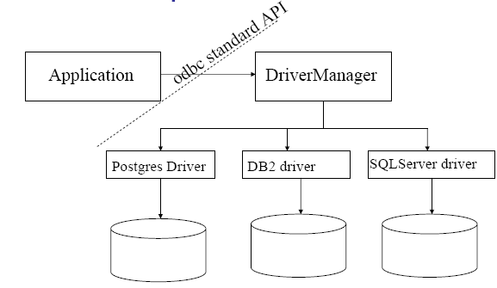
ODBC的体系结构（2）
用户的ODBC应用程序如何和数据库交互
ODBC API提供的接口函数
SQL

Slide 7
ODBC的体系结构（3）
驱动程序管理器(ODBC Driver Manager)的主要作用
管理应用程序和驱动程序的通信
装载、管理驱动程序
管理和配置数据源
负责的主要文件
…\system32\odbc32.dll
数据库驱动程序(ODBC Driver)的作用
对相应的数据源进行各种操作
数据库驱动程序(ODBC Driver)的调用方式
以动态链接库形式(*.DLL)存在
由应用程序命令装载，由驱动程序管理器负责装载

Slide 8
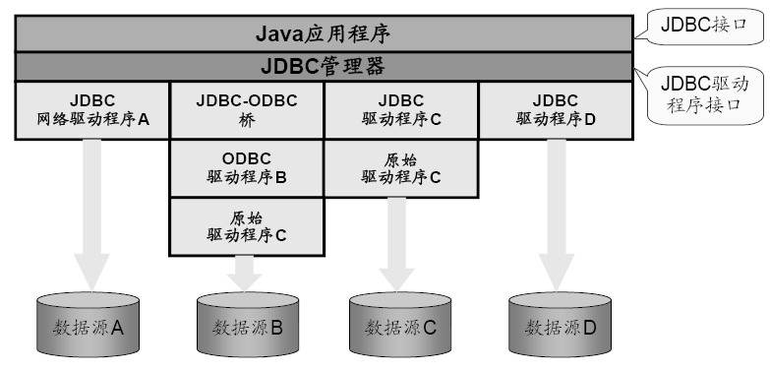
JDBC
提供了一组标准API，用于访问关系数据库
API类库位于java.sql.*和java.sqlx.*中
为Applet、Servlet和应用程序提供了统一的访问方式
JDBC提供的并不是嵌入式的结构化查询语言

Slide 9
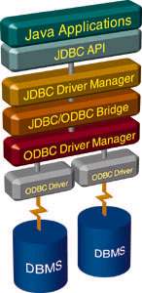
JDBC构成的组件
JDBC应用程序
驱动程序管理器
驱动程序
需要把各个DBMS提供jdbc包放到某个路径下并指明classpath
数据源

Slide 10
应用JDBC的七个步骤
装载驱动程序
定义连接的URL
建立连接关系
创建一个Statement对象
执行一个查询
处理结果集关闭连接

Slide 11
JDBC Code
public static void JDBCexample(String dbid, String userid, String passwd)
{
try {
Class.forName ("oracle.jdbc.driver.OracleDriver");
Connection conn = DriverManager.getConnection( "jdbc:oracle:thin:@db.yale.edu:2000:univdb", userid, passwd);
Statement stmt = conn.createStatement();
… Do Actual Work ….
stmt.close();
conn.close();
}
catch (SQLException sqle) {
System.out.println("SQLException : " + sqle);
}
}

Slide 12
JDBC Code (Cont.)
Update to database try { stmt.executeUpdate( "insert into instructor values(’77987’, ’Kim’, ’Physics’, 98000)"); } catch (SQLException sqle) { System.out.println("Could not insert tuple. " + sqle); }
Execute query and fetch and print results
ResultSet rset = stmt.executeQuery( "select dept_name, avg (salary) from instructor group by dept_name"); while (rset.next()) { System.out.println(rset.getString("dept_name") + " " + rset.getFloat(2)); }

Slide 13
JDBC Code Details
Getting result fields:
rs.getString(“dept_name”) and rs.getString(1) equivalent if dept_name is the first argument of select result.
Dealing with Null values
int a = rs.getInt(“a”);
if (rs.wasNull()) Systems.out.println(“Got null value”);

Slide 14
JDBC应用实例（JSP）
<%@ page language="java" import="java.io.*,java.sql.*,javax.sql.* ,javax.naming.*"%>
<%@ page contentType="text/html;charset=gb2312" %>
<%
String sDBDriver = "oracle.jdbc.driver.OracleDriver";
String sConnStr = "jdbc:oracle:thin:@192.168.0.58:1521:ORCL";
/*代表对特定数据库的连接 */
Connection conn = null;
/*控制对一个特定语句的行数据的存取*/
ResultSet rs = null;
/*代表一个特定的容器， 对一个特定的数据库执行SQL 语句*/
Statement stmt = null;

Slide 15
try
{
Class.forName(sDBDriver);
conn = DriverManager.getConnection(sConnStr,"veh_admin","oracle");
stmt = conn.createStatement();
//stmt.executeQuery("create table aaa(aaa int)");
//stmt.executeUpdate("insert into bbb values(456)");
rs = stmt.executeQuery("select * from S");
while (rs.next()){
out.println("" + rs.getInt(1) + "");
out.println(":"+"<br>");
out.println(" + rs.getString(‘SN') + ");
}
rs.close();
}
catch(Exception e)
{
out.println(e);
}
200730551019 | 蔡锐涛
200730551041 | 陈博
200730551091 | 陈冠良
200730551154 | 陈佳鹏
200730551271 | 陈晓鸣
200730551348 | 陈智
200730551352 | 陈琬诗
200730551447 | 方晓霖
…… | ……

Slide 16
Embedded SQL
The SQL standard defines embeddings of SQL in a variety of programming languages such as C, Java, and Cobol.
A language to which SQL queries are embedded is referred to as a host language, and the SQL structures permitted in the host language comprise embedded SQL.
The basic form of these languages follows that of the System R embedding of SQL into PL/I.
EXEC SQL statement is used to identify embedded SQL request to the preprocessor
EXEC SQL <embedded SQL statement > END_EXEC
Note: this varies by language (for example, the Java embedding uses # SQL { …. }; )

Slide 17
Example Query
Specify the query in SQL and declare a cursor for it
EXEC SQL
declare c cursor for select ID, name from student where tot_cred > :credit_amount
END_EXEC
From within a host language, find the ID and name of students who have completed more than the number of credits stored in variable credit_amount.

Slide 18
Embedded SQL (Cont.)
The open statement causes the query to be evaluated
EXEC SQL open c END_EXEC
The fetch statement causes the values of one tuple in the query result to be placed on host language variables.
EXEC SQL fetch c into :si, :sn END_EXEC Repeated calls to fetch get successive tuples in the query result
A variable called SQLSTATE in the SQL communication area (SQLCA) gets set to ‘02000’ to indicate no more data is available
The close statement causes the database system to delete the temporary relation that holds the result of the query.
EXEC SQL close c END_EXEC
Note: above details vary with language. For example, the Java embedding defines Java iterators to step through result tuples.

Slide 19
Updates Through Cursors
Can update tuples fetched by cursor by declaring that the cursor is for update
declare c cursor for select * from instructor where dept_name = ‘Music’ for update
To update tuple at the current location of cursor c
update instructor set salary = salary + 100 where current of c

Slide 20
Procedural Constructs in SQL

Slide 21
Procedural Extensions and Stored Procedures
SQL provides a module language
Permits definition of procedures in SQL, with if-then-else statements, for and while loops, etc.
Stored Procedures
Can store procedures in the database
then execute them using the call statement
permit external applications to operate on the database without knowing about internal details
Object-oriented aspects of these features are covered in Chapter 22 (Object Based Databases)

Slide 22
Functions and Procedures
SQL:1999 supports functions and procedures
Functions/procedures can be written in SQL itself, or in an external programming language.
Functions are particularly useful with specialized data types such as images and geometric objects.
Example: functions to check if polygons overlap, or to compare images for similarity.
Some database systems support table-valued functions, which can return a relation as a result.
SQL:1999 also supports a rich set of imperative constructs, including
Loops, if-then-else, assignment
Many databases have proprietary procedural extensions to SQL that differ from SQL:1999.

Slide 23
SQL Functions
Define a function that, given the name of a department, returns the count of the number of instructors in that department.
create function dept_count (dept_name varchar(20)) returns integer begin declare d_count integer; select count (* ) into d_count from instructor where instructor.dept_name = dept_name return d_count; end
Find the department name and budget of all departments with more that 12 instructors.
select dept_name, budget from department where dept_count (dept_name ) > 1

Slide 24
Table Functions
SQL:2003 added functions that return a relation as a result
Example: Return all accounts owned by a given customer
create function instructors_of (dept_name char(20)
returns table ( ID varchar(5), name varchar(20), dept_name varchar(20), salary numeric(8,2))
return table (select ID, name, dept_name, salary from instructor where instructor.dept_name = instructors_of.dept_name)
Usage
select * from table (instructors_of (‘Music’))

Slide 25
Stored Procedure
存储过程将常用的或很复杂的工作，预先用SQL语句写好并用一个指定的名称存储起来，当需要数据库提供与已定义好的存储过程的功能相同的服务时，直接调用即可自动完成命令。
存储过程就像函数一样，也具有传递参数和执行逻辑表达式的功能，但存储过程又与函数不同，因为存储过程不返回取代其名称的值，也不能直接在表达式中使用。
由于存储过程提供了一种高效和安全的访问数据库的方法，它经常被用来访问数据和管理被修改的数据。

Slide 26
SQL Procedures
The dept_count function could instead be written as procedure:
create procedure dept_count_proc (in dept_name varchar(20), out d_count integer) begin
select count(*) into d_count from instructor where instructor.dept_name = dept_count_proc.dept_name
end
Procedures can be invoked either from an SQL procedure or from embedded SQL, using the call statement.
declare d_count integer; call dept_count_proc( ‘Physics’, d_count);
Procedures and functions can be invoked also from dynamic SQL
SQL:1999 allows more than one function/procedure of the same name (called name overloading), as long as the number of arguments differ, or at least the types of the arguments differ

Slide 27
存储过程具有以下优点
存储过程允许标准组件式编程
存储过程在被创建以后可以在程序中被多次调用，而不必重新编写该存储过程的SQL 语句。而且数据库专业人员可随时对存储过程进行修改，但对应用程序源代码毫无影响（因为应用程序源代码只包含存储过程的调用语句），从而极大地提高了程序的可移植性。
存储过程能够实现较快的执行速度
如果某一操作包含大量的Transaction-SQL 代码或分别被多次执行，那么存储过程要比批处理的执行速度快很多。因为存储过程是预编译的，在首次运行一个存储过程时，查询优化器对其进行分析、优化，并给出最终被存在系统表中的执行计划。而批处理的Transaction- SQL 语句在每次运行时都要进行编译和优化，因此速度相对要慢一些。

Slide 28
存储过程具有以下优点
存储过程能够减少网络流量
对于同一个针对数据数据库对象的操作（如查询、修改），如果这一操作所涉及到的 Transaction-SQL 语句被组织成一存储过程，那么当在客户计算机上调用该存储过程时，网络中传送的只是该调用语句，否则将是多条SQL 语句，从而大大增加了网络流量，降低网络负载。
存储过程可被作为一种安全机制来充分利用
系统管理员通过对执行某一存储过程的权限进行限制，从而能够实现对相应的数据访问权限的限制，避免非授权用户对数据的访问，保证数据的安全。

Slide 29
Triggers

Slide 30
触发器 Trigger
触发器是在对表进行插入（INSERT）、更新（UPDATE）或删除（DELETE）操作时自动执行的存储过程，它是一种特殊类型的存储过程。
触发器这种特殊类型的存储过程，是在基表被修改时自动执行的内嵌过程。
触发器是独立存储在数据库中的独立对象。触发器是现代数据库管理系统用于响应数据变化的一种机制。触发器是实现数据维护规则的有效机制。

Slide 31
Trigger Example
E.g. time_slot_id is not a primary key of timeslot, so we cannot create a foreign key constraint from section to timeslot.
Alternative: use triggers on section and timeslot to enforce integrity constraints
create trigger timeslot_check1 after insert on section referencing new row as nrow for each row when (nrow.time_slot_id not in ( select time_slot_id from time_slot)) /* time_slot_id not present in time_slot */ begin rollback end;

Slide 32
Trigger Example Cont.
create trigger timeslot_check2 after delete on timeslot referencing old row as orow for each row when (orow.time_slot_id not in ( select time_slot_id from time_slot) /* last tuple for time slot id deleted from time slot */ and orow.time_slot_id in ( select time_slot_id from section)) /* and time_slot_id still referenced from section*/ begin rollback end;

Slide 33
Triggering Events and Actions in SQL
Triggering event can be insert, delete or update
Triggers on update can be restricted to specific attributes
E.g., after update of takes on grade
Values of attributes before and after an update can be referenced
referencing old row as : for deletes and updates
referencing new row as : for inserts and updates
Triggers can be activated before an event, which can serve as extra constraints. E.g. convert blank grades to null.
create trigger setnull_trigger before update of takes referencing new row as nrow for each row when (nrow.grade = ‘ ‘) begin atomic set nrow.grade = null; end;

Slide 34
Trigger to Maintain credits_earned value
create trigger credits_earned after update of takes on (grade) referencing new row as nrow referencing old row as orow for each row when nrow.grade <> ’F’ and nrow.grade is not null and (orow.grade = ’F’ or orow.grade is null) begin atomic update student set tot_cred= tot_cred + (select credits from course where course.course_id= nrow.course_id) where student.id = nrow.id; end;

Slide 35
触发器用途
比较不同版本的数据。
读取其他数据库的表中的数据。
在数据库中所有的相关表中级联所作的修改或删除
回滚无效的修改。
强制实现比由CHECK约束提供的限制更为复杂的限制。
执行本地和远程存储过程。

Slide 36
End of Chapter

